Slide 1


Next-Gen IoT Using Li-Fi Technology
Welcome to our presentation on Next-Gen IoT with Li-Fi Technology.
Presenters,
Mohamed Raashidh H IT – 4th Year
Dhivhadhi S.P IT 4th – Year
Abdul Usman R IT 4th – Year
Pavishnath I IT 4th - Year
Department of Information Technology.
Notes:
1

Slide 2
Introduction to Li-Fi Technology
What is Li-Fi?
Advantages
Light Fidelity is a bidirectional, high-speed, and fully networked wireless communication technology. It utilizes visible light communication (VLC) for data transmission within the 400–800 THz (780–375 nm) range of the electromagnetic spectrum. Demonstrated speeds reach up to 224 Gigabits per second in lab conditions.
Security: Data confined to lit area, reducing eavesdropping.
Interference-Free: Not susceptible to radio frequency interference.
Bandwidth: Greater bandwidth availability in the visible light spectrum, offering 10,000 times the spectrum of radio waves.
Li-Fi's unique properties make it ideal for secure, high-bandwidth applications in environments where radio frequencies are restricted or undesirable.
Notes:
2

Slide 3
Li-Fi vs. Wi-Fi: A Comparative Analysis
Speed
Security
Li-Fi: Up to 224 Gbps (lab), 10 Mbps to 1 Gbps (typical deployments).
Li-Fi: High security due to light confinement.
Wi-Fi: Vulnerable to hacking, requires encryption protocols (WPA3).
Wi-Fi: Up to 1.3 Gbps (802.11ac), but real-world speeds are typically 50-200 Mbps.
Range
Applications
Li-Fi: Shorter range, limited to a single room or line of sight.
Li-Fi: Secure data transfer, underwater communication, hospitals.
Wi-Fi: Longer range, can cover entire buildings or outdoor areas.
Wi-Fi: General internet access, home networking, public hotspots.
While Wi-Fi provides broader coverage, Li-Fi excels in security and interference-free environments, making it suitable for specialized applications.
Notes:
3

Slide 4
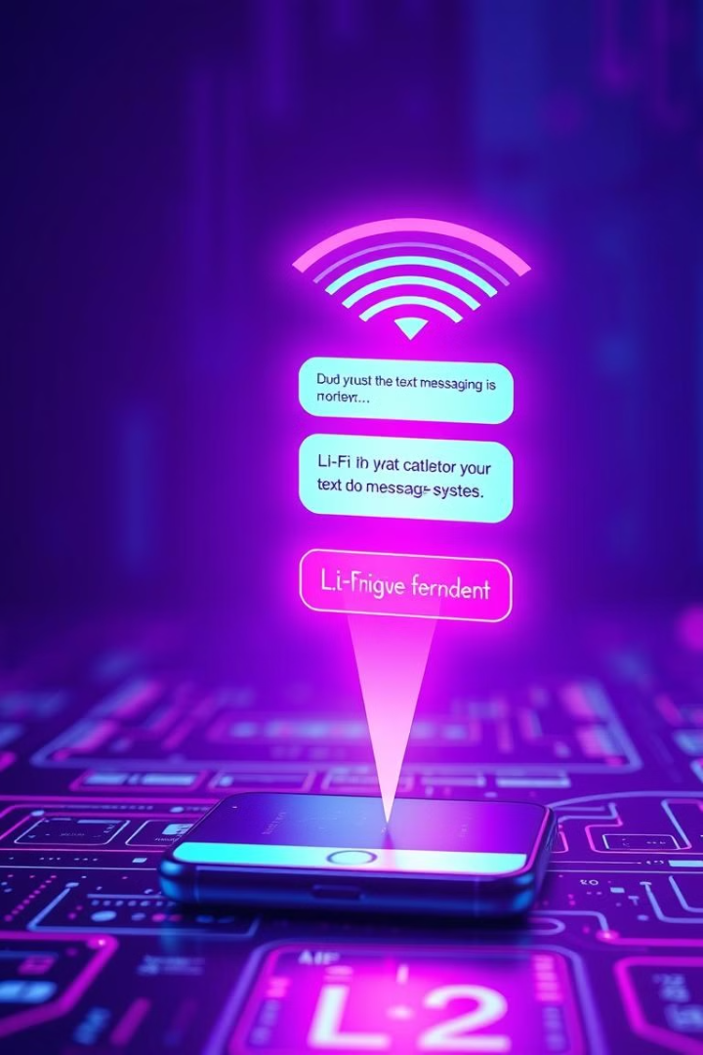




Project Overview: Li-Fi Text Messaging System
Li-Fi App (Smartphone)
Converts text messages into binary code and modulates the flashlight.
LDR Module
Detects flashlight pulses and converts them into electrical signals.
Arduino Uno
Processes signals from the LDR module and decodes binary data.
LCD Screen
Displays the decoded text message.
Our project demonstrates a simple, secure communication channel using Li-Fi technology, showcasing the potential for text messaging via light signals.
Notes:
4

Slide 5
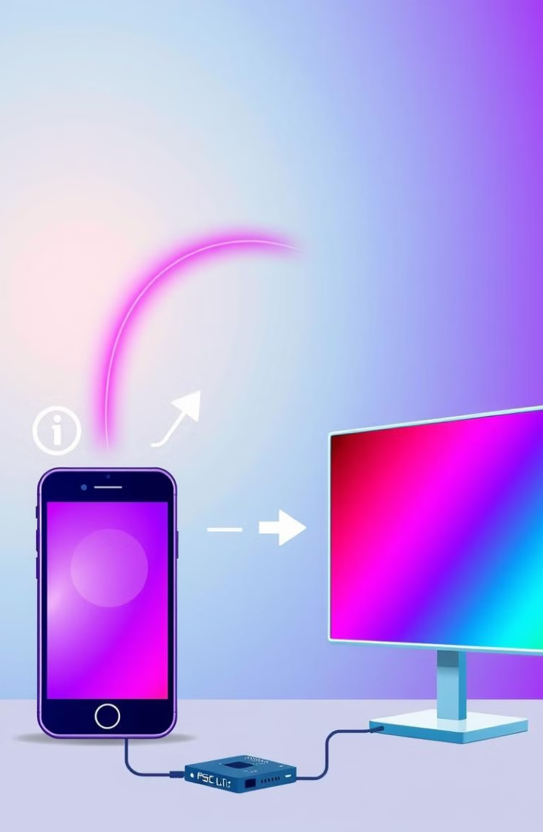
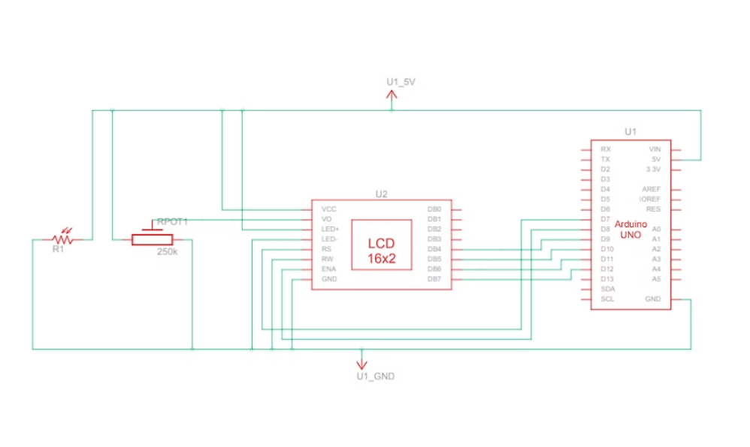
Block Diagram of the Li-Fi System
The following diagram illustrates the flow of data from the Smartphone (Li-Fi App) to the LCD Screen:
Notes:
5

Slide 6
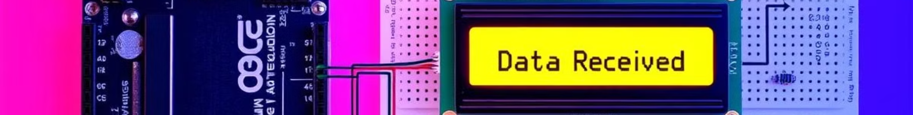
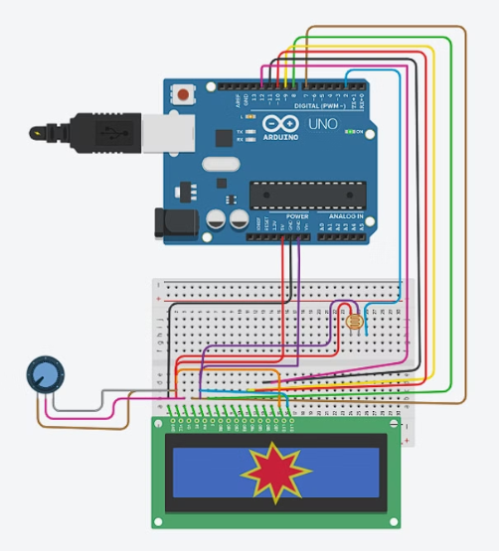
Circuit Diagram of the Receiver (LDR, Arduino, LCD)
This circuit diagram shows the detailed schematic of the LDR module connected to the Arduino Uno, including pin connections for the LDR signal, power (5V), ground, and LCD screen connections for data and control signals.
Notes:
6

Slide 7




Hardware Components: Specifications and Functions
Arduino Uno
Microcontroller: ATmega328P, Clock Speed: 16 MHz, Digital I/O Pins: 14, Memory: 32 KB Flash, 2 KB SRAM, 1 KB EEPROM.
LDR Module
Resistance Range: Typically 1 kΩ in light, up to 1 MΩ in darkness. Operating Voltage: 5V.
LCD Screen
Display Type: HD44780-compatible character LCD. Display Capacity: 16 characters x 2 lines. Operating Voltage: 5V.
Each component plays a critical role in the Li-Fi system, from signal detection to data processing and display.
Notes:
7

Slide 8
Software Implementation: Li-Fi App & Arduino Code
Li-Fi App (Smartphone)
Arduino Code
Algorithm converts text messages into binary code. Modulation technique: On-Off Keying (OOK) – flashlight ON for '1', OFF for '0'. Configurable transmission speed (e.g., 10 bits per second).
Reads analog signals from the LDR module. Filters and thresholds the signal to distinguish between '1' and '0'. Decodes binary data back into text. Displays text on the LCD screen.
The software components are essential for encoding, transmitting, receiving, and decoding data within the Li-Fi system.
Notes:
8

Slide 9
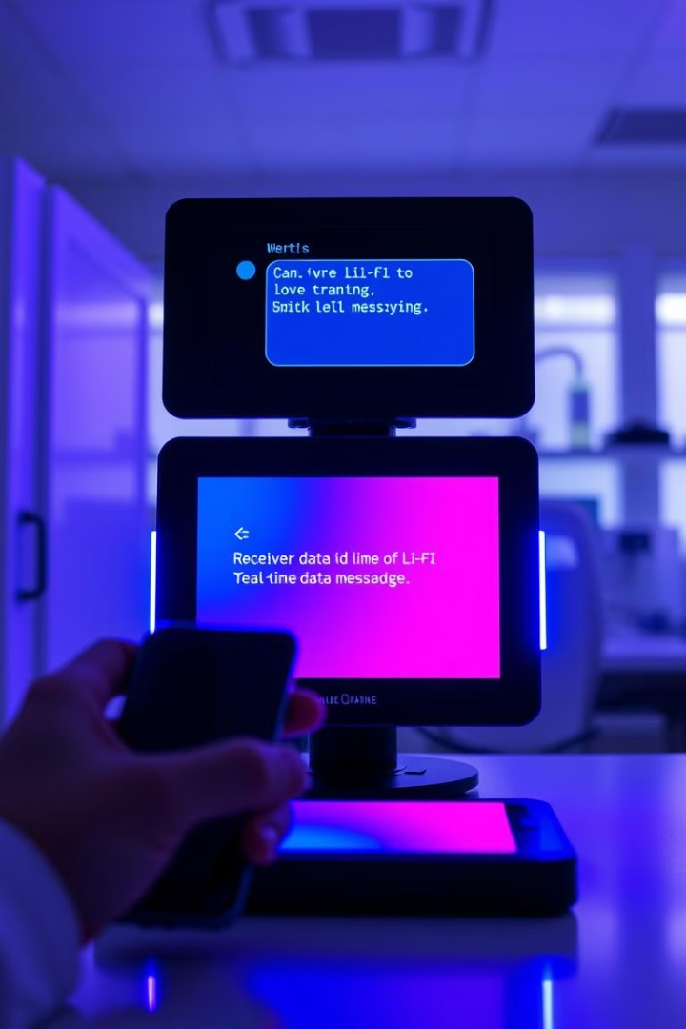




Results and Demonstration
Live Demo
System transmits a text message from the smartphone to the LCD screen.
Impact of Ambient Light
Demonstration of the impact of ambient light on system performance.
Observed Data Transmission Rate
Stable transmission rate of approximately 8 bits per second.
Error Rate
Error rate under controlled lighting conditions was less than 1%.
The live demonstration showcases the effectiveness and limitations of the Li-Fi text messaging system in real-world conditions.
Notes:
9

Slide 10

Conclusion and Future Scope
Future Enhancements
Potential Applications
Implementing error correction codes, exploring higher-speed modulation techniques, developing bidirectional communication.
Summary of Li-Fi Benefits
Secure communication in sensitive environments, underwater data transmission, smart lighting systems.
Enhanced security, reduced interference, high bandwidth potential.
Li-Fi technology holds promise for secure, high-bandwidth communication in various applications. Future enhancements will focus on improving reliability, speed, and functionality.
Notes:
10

